Slide 1
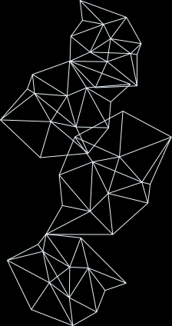


NUTRI LENS AI
Presented by
K PREM KUMAR[24BK1A66BM]
NIRANJAN SINGH[24BK1A66BX]
PRINCE PATEL[24BK1A66CH]
GUIDE
SEMINAR OVERALL COORDINATOR
HOD-CSE(AIML)
Mrs K Katyayani
Dr. E. Madhusudhana Reddy

Slide 2

INTRODUCTION
  NUTRI LENS AI Helps people understand packaged food labels according to their health needs.
  It explains the ingredients, highlights possible risks and suggests healtheir food choices.

Slide 3
PROBLEM STATEMENT
  Food labels are often difficult to understand.
  Users may not know how ingredients affect their health.
  People with conditions like diabetes, high BP, or allergies need personalized food guidance.
  A simple system is needed to explain labels and suggest healthier options.

Slide 4
OBJECTIVE OF THE STUDY
  To read and analyze food labels using AI and OCR
  To explain the food’s health effects based on the user’s health profile
  To suggest healthier alternatives for better food choices

Slide 5
SYSTEM WORK FLOW
  User registers with health details.
  User uploads a food label.
  OCR extracts the ingredients and nutrition.
  AI analyzes the food according to the user’s health profile.
  The system explains the result and suggests a healthier option

Slide 6
TECH STACK
BACKEND
    Python
    Flask 3.0 (web framework)
FRONTEND
    HTML 5 , CSS 3
DATABASE
    MySQl
IMAGE PROCESSING & OCR
    Tesseract OCR

Slide 7
CONCLUSION
  NUTRI LENS AI helps users understand packaged food labels in a simple way.
  It provides personalized health information based on the user’s profile and suggests healthier food choices

Slide 8
THANK YOU

